Slide 1


Slide 2
HYPERBARIC MEDICAL SOLUTIONS
HENRY K. PRINCE, M.D
Medical Director

Slide 3
HYPERBARIC OXYGEN THERAPY
NEW ANSWERS TO OLD QUESTIONS
HOW – WHY - WHEN

Slide 4
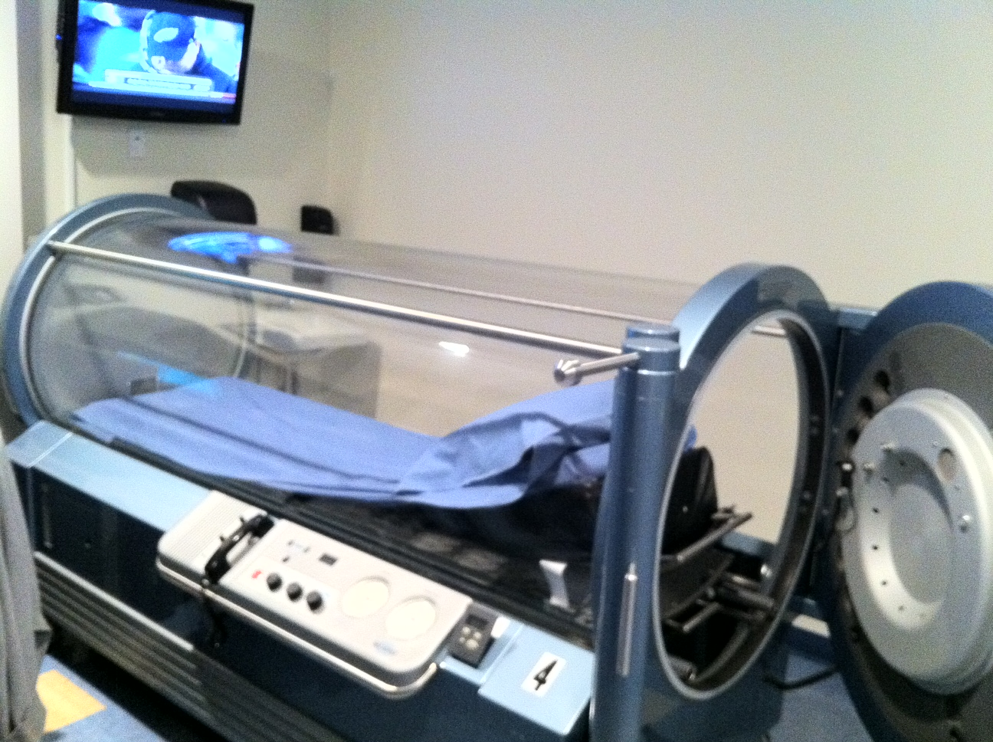
Hyperbaric Medical Solutions
Established in June 2011
HMS is a free-standing Hyperbaric Medical Practice
One of only a handful of free-standing hyperbaric facilities able to treat both “on label” and “off label” disorders
Offering hospital level care in a private practice setting
Located in Medford, Woodbury and now Manhattan
Participating in most insurance plans.

Slide 5
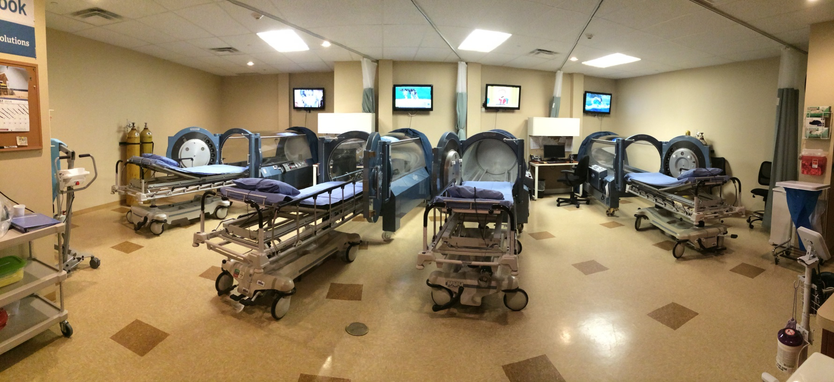
Hyperbaric Medical Solutions®
4 Monoplace Chambers in our Woodbury facility

Slide 6
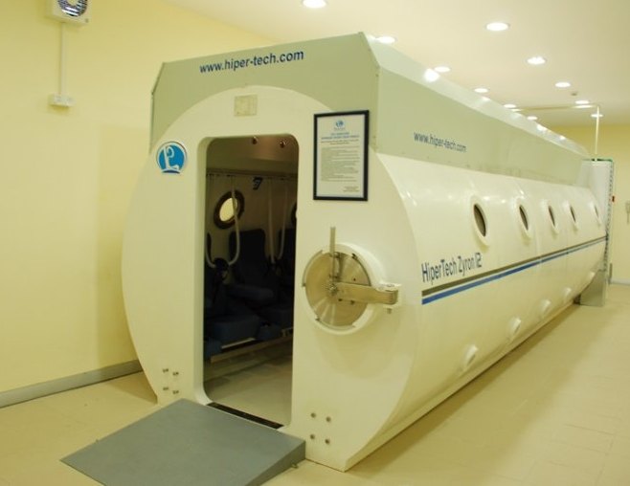
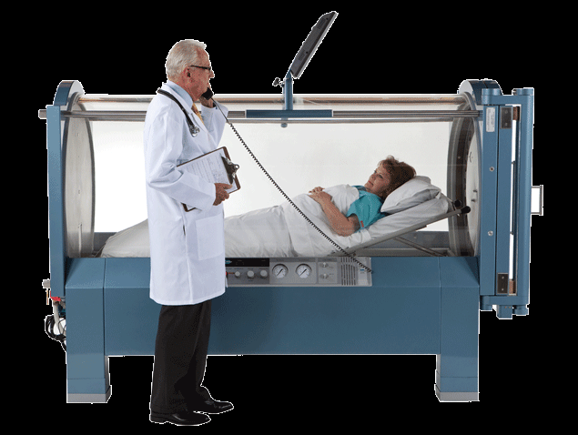
What is HBOT?
Using 100% Oxygen as a drug
Using pressure - 1.5 – 2.4 ATA
Series of one hour treatment sessions
Used for more than 100 years

Slide 7
WHAT IS NOT HBOT
Soft Chamber HBOT
Ozone Therapy
Topical HBO
  This is done by injecting 100% oxygen into a plastic bag encasing the lower limb
    Physiologically impossible to apply pressure to specific body parts without creating a tourniquet effect.
    Very limited depth of penetration, perhaps as shallow as 50-100um

Slide 8
“Cinderella of Modern Medicine”
  Oxygen cannot be patented
  There are no pharmaceutical giants pushing HBOT
  Hyperbaric Medicine is not taught in medical school
  Hyperbaric Medicine crosses many specialties and interests. (Neurology, Infectious Disease, Oncology, Radiation Therapy, Rheumatology, etc.)

Slide 9
Use of Hyperbaric Oxygen Therapy
Two Lists for the

Slide 10
“On Label” – FDA Approved
Diabetic lower extremity ulcers | Arterial Insufficiencies | Severe Anemia**
Delayed Radiation Injury | Gas Gangrene | Intracranial Abscess**
Crush injury | Decompression Sickness | Necrotizing soft tissue infections**
Compromised Skin Grafts and Flaps | Thermal burn Injury | Air or Gas Embolism**
Chronic refractory osteomyelitis* | Sudden Sensorineural Hearing Loss* | Carbon Monoxide Poisoning**
Osteoradionecrosis | Central Retinal Artery Occlusion
* Not yet FDA Approved, but recognized by the UHMS and commonly paid for by insurance
**Mostly seen only in a hospital setting

Slide 11
HBOT’s Emerging Opportunities
Conditions Considered Investigational in United States*
Traumatic brain injury | Autoimmune disorders | Multiple Sclerosis
Concussion (mild traumatic brain injury) | Immune System Support for Cancer patients | Chronic Lyme Disease
Stroke | Inflammatory Gastrointestinal disorders (Ulcerative Colitis & Crohn’s Disease) | Reflex Sympathetic Dystrophy (RSD) / Complex Regional Pain Syndrome (CRPS)
Parkinson’s Disease | Cerebral Palsy | Pre & Post-Operative Surgery
Sports injuries | Osteonecrosis | Stem Cell Harvesting & PRP
*FDA has approved only 13 conditions, but there is ongoing research and study on HBOT’s use for these conditions. Additionally, worldwide HBOT is accepted for use in treating over 40 conditions.

Slide 12
Let me Show You…
HOW CAN WE CLAIM THAT JUST BY GIVING OXYGEN UNDER PRESSURE WE CAN TREAT SO MANY DIVERSE CONDITIONS?

Slide 13
PHYSICS
PRESSURE = FORCE/AREA
ATMOSPHERIC PRESSURE =
  14.7 LBS/SQ INCH =
    760 MM Hg
      =1 ATMOSPHERE
Pressure at 33 feet under water is equal to:
  1ATM of Hydrostatic Pressure + 1 ATM of Air Pressure equaling
    2 ATMOSPHERES = 2 ATA

Slide 14
THE PHYSICS OF HYPERBARIC THERAPY
GAS LAWS
Boyle’s Law- As the pressure increases the gas bubble volume decreases
Henry’s Law - The amount of gas dissolved in a liquid is equal to the partial pressure of the gas exerted on the surface of the liquid. (By increasing the atmospheric pressure, more oxygen can be dissolved into the plasma).

Slide 15
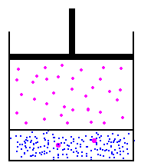
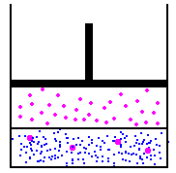
Henry’s Law
(No not mine)
  The amount of gas that will dissolve in a liquid is proportional to the gas pressure

Slide 16
MECHANISM OF ACTION
THE AIR WE BREATHE HAS 21% O2
AS WE SIT HERE TODAY THE OXYGEN LEVEL IN OUR ARTERIES IS 100 MM Hg
AT 2 ATA THE OXYGEN LEVEL IN OUR ARTERIES = 1400 MM Hg
THAT IS AN INCREASE OF 14X

Slide 17
Mechanisms of Action
HYPEROXYGENATION
  At room air oxygen diffuses out to 64 Microns
  _____
  At 2 ATA Oxygen diffuses out to 250 Microns
  ____________________

Slide 18
Mechanisms of Action
NEOVASCULARIZATION / ANGIOGENESIS
  The production of new blood vessels
  Activation and proliferation of fibroblasts
  Promotion of collagen synthesis
  Vascular proliferation along collagen fibers
  Stimulates the recruitment and differentiation of stem cells/progenitor cells to form new blood vessels

Slide 19
Mechanisms of Action
Anti-Inflammatory Action
  Reperfusion Injury
    After an injury, when blood flow is restored to the area (reperfusion), the initial inflammatory events actually increase local damage.
HBO temporarily prevents adherence of inflammatory cells to damaged cell walls, thus reducing reperfusion damage

Slide 20
Mechanisms of Action
ENHANCED RESISTANCE TO INFECTION
  The killing capacity of white blood cells (wbc) is normal only to the degree that oxygen is available
  Anaerobes live better in hypoxic environments because of their metabolic patterns
  Aerobes live better in low oxygen environments because of impaired wbc function

Slide 21
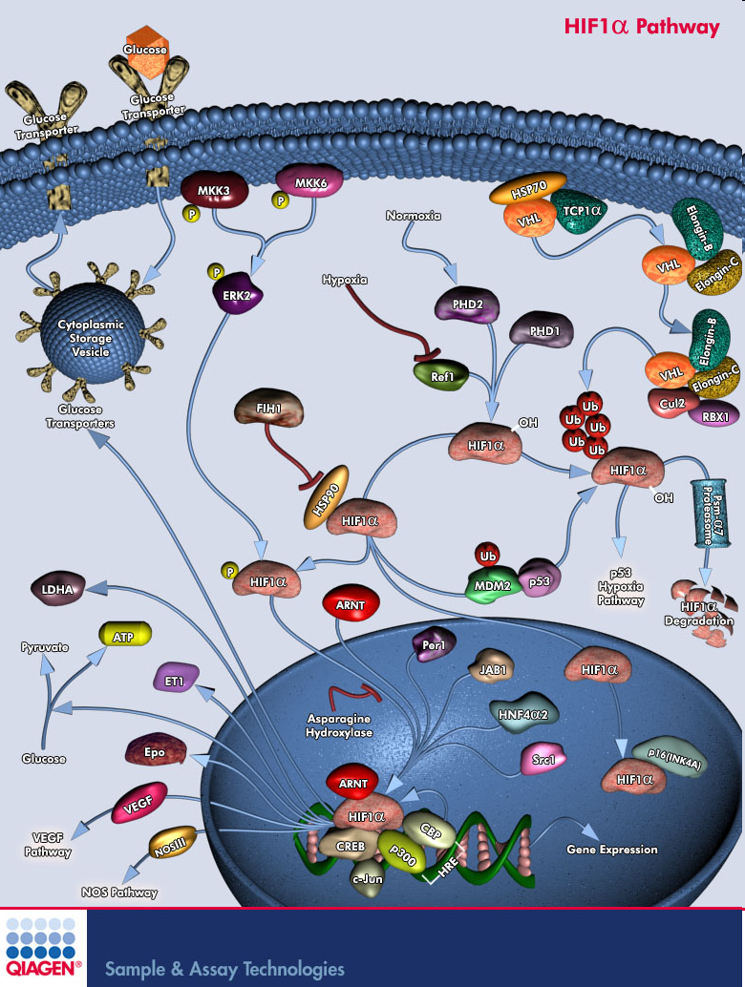
How it works - 5,769+* ways
(~# of cellular processes studied)
Upregulates growth factors
Reduces edema/swelling
Promotes neural pathway growth
Activates senescent neurons [“sleeping”, not dead]
Increases neuronal energy [ATP]
Downregulates inflammation
Reduces reperfusion injury [not enough O2]
*Rink C, Roy S, Khan M, Ananth P, Kuppusamy P, Sen CK, Khanna S. Oxygen-sensitive outcomes and gene expression in acute ischemic stroke. J Cereb Blood Flow Metab. 2010 Feb 10.

Slide 22
POSITIVE EFFECTS OF HBOT
ALTERATION OF ISCHEMIC EFFECT
REDUCTION OF EDEMA
MODULATION OF PRODUCTION OF NITRIC OXIDE
MODULATION OF THE EFFECT OF GROWTH FACTORS AND CYTOKINES
PROMOTION OF CELLULAR PROLIFERATION
ACCELERATION OF COLLAGEN DEPOSITION
STIMULATION OF CAPILLARY BUDDING
ACCELERATED MICROBIAL OXIDATIVE KILLING
INTERFERENCE WITH BACTERIAL PROLIFERATION
MODULATION OF THE IMMUNE SYSTEM RESPONSE
ENHANCEMENT OF OXYGEN RELATED SCAVANGERS, THEREBY REDUCING ISCHEMIA REPREFUSION INJURY

Slide 23
HBOT CONTRAINDICATIONS
PNEUMOTHORAX

Slide 24
HBOT CONTRAINDICATIONS
Most drugs have no adverse effects when combined with HBOT
SIGNIFICANT EXCEPTIONS
ADRIAMYCIN
SULFAMYLON
BLEOMYCIN( OK IF NORMAL PFT)
ANTABUSE

Slide 25
RELATIVE CONTRAINDICATIONS
Seizure disorders
Cis-Platinum (slows wound healing)
COPD
HISTORY of pneumothorax
Viral infections (fevers)
Congenital spherocytosis and sickle cell disease
Sinusitis

Slide 26
RELATIVE CONTRAINDICATIONS
Implanted devices( need to investigate ability to function under pressure)
Pregnancy
  Retrolental fibroplasia
  Premature closure of the ductus arteriosis
    (need 12 hours continuous increased oxygen)
Congestive heart disease

Slide 27
HBOT SIDE EFFECTS
RELATIVELY FEW SIDE EFFECTS
ALL CAN BE MANAGED

Slide 28
HBOT SIDE EFFECTS
  Barotitis
  Sinus squeeze
  Oxygen seizures
  Confinement anxiety
  Pneumothorax
Ocular changes
  Transient myopia
  Maturation of cataracts
Oxygen toxicity
Hypoglycemia

Slide 29
CHRONIC WOUNDS
A chronic wound is one in which healing fails to proceed through an orderly and timely process and fails to produce anatomic and functional integrity.
These wounds are often a surface manifestation of an underlying disease such as venous insufficiency, arterial disease or diabetes

Slide 30
CHRONIC WOUNDS
WOUNDS FOR WHICH HBOT IS INDICATED
NOT COVERED
  DIABETIC FOOT ULCERS
  ARTERIAL INSUFFICIENCY ULCERS
PRESSUREE ULCERS
VENOUS STASIS ULCERS

Slide 31
DIABETIC WOUNDS SCOPE OF THE PROBLEM
25.8 MILLION DIABETICS IN US
  45% 5 year mortality with DFU and neuropathy
  55% 5 year mortality with DFU, Neuropathy and PAD
  80% 5 year mortality with DFU< neuropathy, PASD and CRF

Slide 32
DIABETIC FOOT ULCERS
INCREASED NUMBERS
INCREASED EXPENSES
INCREASED COMPLEXITY
RESISTANT BACTERIA
SURVIVAL RATES WORSE THAN MANY CANCERS

Slide 33
DIABETIC WOUNDS
Diabetic wounds of the lower extremity which meet the following criteria:
  The patient has type I or type II diabetes and has a lower extremity wound that is due to diabetes
  The patient has a wound classifieds as Wagner Grade III or higher
  The patient has failed an adequate course of standard wound therapy

Slide 34
DIABETIC WOUNDS
The use of HBO therapy is covered as adjunctive therapy only after there are no measurable signs of healing for at least 30 days of treatment with standard wound therapy and must be used in addition to standard wound care

Slide 35
DIABETIC WOUNDS
WAGNER CLASSIFICATIONS
  Grade 0
    intact skin
  Grade 1
    Superficial ulceration of the skin
  Grade 2
    Ulcer penetrates to tendon, bone or joint

Slide 36
DIABETIC WOUNDS
WAGNER CLASSIFICATION
  Grade 3
    Lesion has penetrated deeper than Grade 2 and there is abscess, osteomyelitis, pyarthrosis, plantar space abscess, or infection of the tendon and tendon sheath
  Grade 4
    Gangrene of the forefoot
  Grade 5
    Gangrene of the entire foot

Slide 37
DIABETIC WOUNDS
Standard wound therapy
  HBO covered after failure of standard wound therapy with no measurable signs of healing for 30 days
    Assessment of patients vascular status and correction of any vascular problems in the affected limb if possible
    Optimization of nutritional status
    Optimization of glucose control
    Debridement by any means to remove devitalized tissue

Slide 38
DIABETIC WOUNDS
Standard wound therapy
  Maintenance of clean moist bed of granulation tissue with appropriate moist dressings
  Appropriate off loading
  Necessary treatment to resolve any infection

Slide 39
ARTERIAL INSUFFICIENCY ULCERS
The primary treatment of refractory ischemic wounds of the lower extremities is improvement in blood flow by angioplasty, surgical revascularization, or other interventional techniques.
HBO may be of benefit in those cases where persistent hypoxia remains after attempts at increasing blood flow, or when wound failure continues in spite of optimal revascularization

Slide 40
ARTERIAL INSUFFICIENCY ULCERS
Research demonstrates:
  Reduction in expression of HIF-1 alpha
  Reduction of inflammatory mediators resulting in attenuation of cell apoptosis

Slide 41
RADIATION
Proven to be effective in the treatment of breast cancer
Goal irradiate tumor with minimal effect on surrounding normal tissue
Optimal dosage to provide an acceptable benefit/damage ratio
Radiation induced tissue necrosis is a complication even with accepted dosage schedules

Slide 42
RADIATION PHYSICS
Two types of ionizing radiation
  Electromagnetic radiation= bundles of energy called photons
    Gamma rays if originates from the atomic nucleus
    X-rays if it originates from the shell around the nucleus
  Particulate Radiation = protons and neutrons

Slide 43
RADIATION
The chemical effects of Radiation are:
  Damage to the protein structure
  Lipid Peroxidation
  DNA damage
The cell DNA is the critical target
The radiation sensitivity of a cell is greatest just prior to mitosis
The radiosensitivity of a cell is directly proportional to their mitotic activity and inversely proportional to their level of specialization
Connective tissue (Vascular endothelium) has an intermediate radiosensitivity

Slide 44
RADIATION
PATHOLOGICAL SEQUENCE OF EVENTS
  ACUTE - 1st 6 months accumulation of acute organ damage which may be clinically silent
  SUBACUTE 2nd 6 months persistence and progression of permanent tissue damage
  CHRONIC 2nd – 5th year Further progression of chronic progressive residual damage. Deterioration of microvasculature with hypoperfusion, parenchymal damage and reduced resistance to infection
  LATE CHRONIC Further progression of changes

Slide 45
RADIATION
Radiation damage progresses slowly and continues long after the RT has been discontinued. Damaged cells do not reproduce, and otherwise normal cells may fail to reproduce because of loss of vascularity.
There is a loss of collagen and increased fibrosis
Oxygen tension in a radiated area is 5-10 mm Hg

Slide 46
RADIATION
BLOOD VESSELS
  Swelling degeneration and necrosis
  Thickening of the vessel wall
  Proliferative endarteritis
  Necrotizing vasculitis
  Arterioles and capillaries most damaged
  Larger vessels often spared

Slide 47
RADIATION
USUAL SITES OF NECROSIS
    The mandible absorbs more radiation than the maxilla because of it’s greater density and lower vascularity
    Ribs after RT for Breast Cancer
    Skull after RT for brain tumors
    Pelvis after RT for pelvic tumors

Slide 48
HBOT AND RADIATION
ANGIOGENESIS

Slide 49


Hyperbaric Medical Solutions® www.hyperbaricmedicalsolutions.com
Woodbury 80 Crossways Park Drive Woodbury, NY 11797 p: 516.802.5025 f: 516.802.5026 | Medford 12 Platinum Ct Medford, NY 11763 p: 631.504.6800 f: 631.504.6803 | Manhattan 160 East 32nd Street New York, NY 10016 p: 646.742.8888 f: 516.802.5026

